Slide 1
Arithmetic circuits

Slide 2
Shifters
Logical shifter: shifts value to left or right and fills empty spaces with 0’s
Ex: 11001 >> 2 =
Ex: 11001 << 2 =
Arithmetic shifter: same as logical shifter, but on right shift, fills empty spaces with the old most significant bit (msb)
Ex: 11001 >>> 2 =
Ex: 11001 <<< 2 =
Rotator: rotates bits in a circle, such that bits shifted off one end are shifted into the other end
Ex: 11001 ROR 2 =
Ex: 11001 ROL 2 =

Slide 3
Shifters
Logical shifter:
Ex: 11001 >> 2 = 00110
Ex: 11001 << 2 = 00100
Arithmetic shifter:
Ex: 11001 >>> 2 = 11110
Ex: 11001 <<< 2 = 00100
Rotator:
Ex: 11001 ROR 2 = 01110
Ex: 11001 ROL 2 = 00111

Slide 4
Shifter Design

Slide 5
Shifters as Multipliers, Dividers
A << N = A × 2^{N}
Example: 00001 << 2 = 00100 (1 × 2² = 4)
Example: 11101 << 2 = 10100 (-3 × 2² = -12)
A >>> N = A ÷ 2^{N}
Example: 01000 >>> 2 = 00010 (8 ÷ 2² = 2)
Example: 10000 >>> 2 = 11100 (-16 ÷ 2² = -4)

Slide 6
Esercizi
Esercizio 1: Convertire i seguenti numeri decimali in complemento a 2 utilizzando 8 bits. Dividere il risultato per 4 utilizzando lo shift a destra. Riconvertire i numeri in decimale.
108
-13
105
-128
-99
Esercizio 2: Convertire i seguenti numeri decimali in complemento a 2 utilizzando 8 bits. Moltiplicare il risultato per 4 utilizzando lo shift a sinistra. Riconvertire i numeri in decimale.
108
25
-33
-32
Exercise 5.18 Design 4-bit left and right rotators. Sketch a schematic of your design.

Slide 7
Exercises
Exercise 5.18 Design 4-bit left and right rotators. Sketch a schematic of your design.

Slide 8
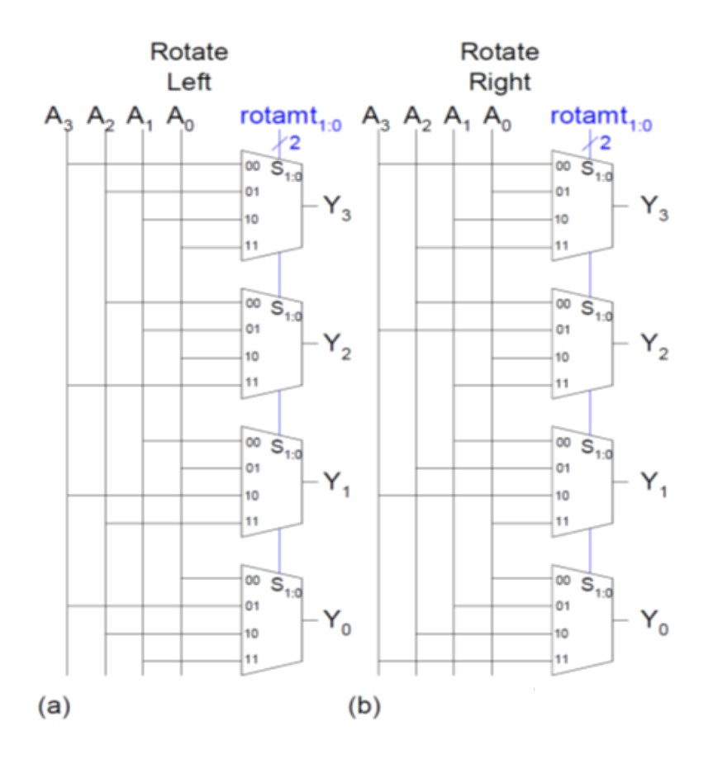
Exercises
Exercise 5.18 Design 4-bit left and right rotators. Sketch a schematic of your design.

Slide 9
Multipliers
Partial products formed by multiplying a single digit of the multiplier with multiplicand
Shifted partial products summed to form result

Slide 10
4 x 4 Multiplier

Slide 11
Counters
Increments on each clock edge
Used to cycle through numbers. For example,
000, 001, 010, 011, 100, 101, 110, 111, 000, 001…
Example uses:
Digital clock displays
Program counter: keeps track of current instruction executing

Slide 12
Counters
Increments on each clock edge
Used to cycle through numbers. For example,
000, 001, 010, 011, 100, 101, 110, 111, 000, 001…
Example uses:
Digital clock displays
Program counter: keeps track of current instruction executing

Slide 13
Shift Registers
Shift a new bit in on each clock edge
Shift a bit out on each clock edge
Serial-to-parallel converter: converts serial input (S_{in}) to parallel output (Q_{0:N-1})
Symbol:
Implementation:

Slide 14
Shift Register with Parallel Load
When Load = 1, acts as a normal N-bit register
When Load = 0, acts as a shift register
Now can act as a serial-to-parallel converter (S_{in} to Q_{0:N-1}) or a parallel-to-serial converter (D_{0:N-1} to S_{out})

Slide 15
Shift Register with Parallel Load
When Load = 1, acts as a normal N-bit register
When Load = 0, acts as a shift register
Now can act as a serial-to-parallel converter (S_{in} to Q_{0:N-1}) or a parallel-to-serial converter (D_{0:N-1} to S_{out})

Slide 16
Trasmissione seriale
Gli shifter registers possono essere utilizzzati per realizzare un trasmettitore seriale
Gli N bit di dato D_{in} sono inviati allo shifter register SR₁
I segnali di clock e S_{out} sono inviati al ricevitore SR₂
SR₂ viene utilizzato per ricostruire il dato D_{out}
Load
SR₁
SR₂
N
S_{out}
N
D_{in}
D_{out}
clk

Slide 17
Memorie

Slide 18
Memory Arrays
Efficiently store large amounts of data
3 common types:
Dynamic random access memory (DRAM)
Static random access memory (SRAM)
Read only memory (ROM)
M-bit data value read/ written at each unique N-bit address

Slide 19
Memory Arrays
2-dimensional array of bit cells
Each bit cell stores one bit
N address bits and M data bits:
2^{N} rows and M columns
Depth: number of rows (number of words)
Width: number of columns (size of word)
Array size: depth × width = 2^{N} × M

Slide 20
Memory Array Example
2² × 3-bit array
Number of words: 4
Word size: 3-bits
For example, the 3-bit word stored at address 10 is 100

Slide 21
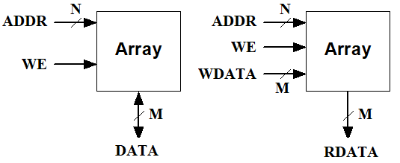
Memory Arrays
A RAM array has the following ports:
Address port with 2^{N}xM bits has:
N address bits (inputs)
M bidirectional data bits. Or M read_data output bits + M write_data input bits
A WE (Write Enable) signal

Slide 22
Memory Array Bit Cells

Slide 23
Memory Array Bit Cells
0
Z
1
Z

Slide 24
Memory Array
Wordline:
like an enable
single row in memory array read/written
corresponds to unique address
only one wordline HIGH at once

Slide 25
Types of Memory
Random access memory (RAM): volatile
Read only memory (ROM): nonvolatile

Slide 26
RAM: Random Access Memory
Volatile: loses its data when power off
Read and written quickly
Main memory in your computer is RAM (DRAM)
Historically called random access memory because any data word accessed as easily as any other (in contrast to sequential access memories such as a tape recorder)

Slide 27
ROM: Read Only Memory
Nonvolatile: retains data when power off
Read quickly, but writing is impossible or slow
Flash memory in cameras, thumb drives, and digital cameras are all ROMs
Historically called read only memory because ROMs were written at manufacturing time or by burning fuses. Once ROM was configured, it could not be written again. This is no longer the case for Flash memory and other types of ROMs.

Slide 28
Types of RAM
DRAM (Dynamic random access memory)
SRAM (Static random access memory)
Differ in how they store data:
DRAM uses a capacitor
SRAM uses cross-coupled inverters

Slide 29
DRAM
Data bits stored on capacitor
Dynamic because the value needs to be refreshed (rewritten) periodically and after read:
Charge leakage from the capacitor degrades the value
Reading destroys the stored value

Slide 30
DRAM

Slide 31
SRAM

Slide 32
Memory Arrays Review
DRAM bit cell:
SRAM bit cell:

Slide 33
Esercizi
Esercizio 1: Costruire una memoria di 1 MB e larghezza di parola di 32 bits a partire da blocchi di memoria di dimensioni 2¹⁸ × 8
Esercizio 2: Costruire una memoria di 1 MB e larghezza di parola di 32 bits a partire da blocchi di memoria di dimensioni 2¹⁶ × 32
Esercizio 3: Costruire una memoria di 1 MB e larghezza di parola di 8 bits a partire da blocchi di memoria di dimensioni 2¹⁸ × 32

